Slide 1
Inverse Trigonometric Functions
Math 12
Q1, 2010-11

Slide 2
Inverse Trigonometric Functions
If sin y = x, then y = Arcsin x or Sin⁻¹ x
cos y = x, then y = Arccos x or Cos⁻¹ x
tan y = x, then y = Arctan x or Tan⁻¹ x
sec y = x, then y = Arcsec x or Sec⁻¹ x
csc y = x, then y = Arccsc x or Csc⁻¹ x
cot y = x, then y = Arccot x or Cot⁻¹ x
For a function to have an inverse, say, sin y = x, it must be one to one, meaning that for every value of x there corresponds one and only one value of the function y.
Since trigonometric functions are not one to one, they do not have inverses. However, it is possible to restrict the domains of the trigonometric functions in such a way that the resulting functions are one to one.

Slide 3
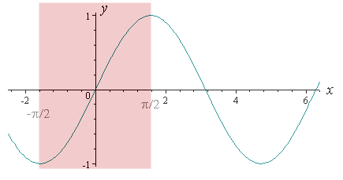
Consider the sine function:
For the function to be one to one, the natural way is to restrict the domain to the interval (-π/2,π/2)
The reason for the choice is that sine attains each of its values exactly once in this interval.
y=sin x
y=sin x, -π/2 ≤ x ≤ π/2 (Domain)

Slide 4
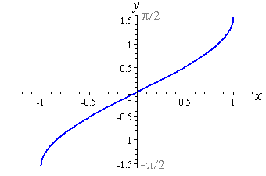

Inverse of Sine function: is the function Sin⁻¹ defined by
y= Sin⁻¹ x if and only if sin y = x
for Domain: -1 ≤ x ≤ 1 and
Range: -π/2 ≤ y ≤ π/2
y= Sin⁻¹ x
Note: To denote the function form of the trigonometric inverses, we use the initial capital letter, such as Arcsin or Sin⁻¹, Arccos or Cos⁻¹, etc.
Notes:
Note: To denote the function

Slide 5
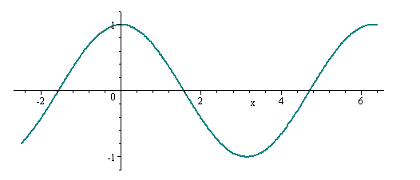
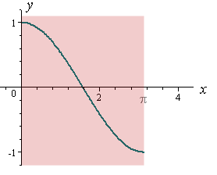
Consider the cosine function:
y=cos x
We now restrict the domain of this graph from x = 0 to x = π.
y=cos x, 0 ≤ x ≤ π (Domain)
-1 ≤ x ≤ 1 (Range)

Slide 6
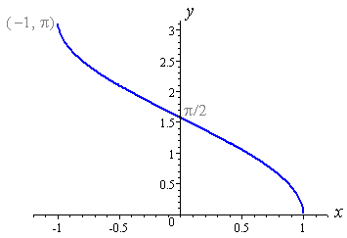
Inverse of Cosine function: is the function Sin⁻¹ defined by
y= Cos⁻¹ x if and only if cos y = x
for Domain: -1 ≤ x ≤ 1 and
Range: 0 ≤ y ≤ π
Then we reflect the graph y= Cos⁻¹ x
y | 0 | π/2 | π
x | 1 | 0 | -1
Notes:
Note: To denote the function

Slide 7
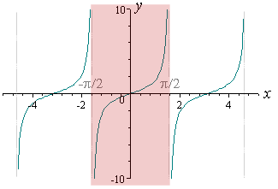
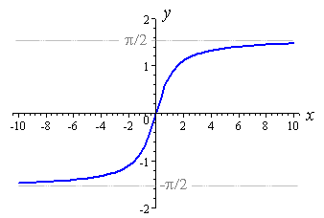
Inverse Tangent Function: is defined by
y= Tan⁻¹ x or Arctan x if and only if tan y = x
for all real nos. of x (Domain: -∞ ≤ x ≤ ∞) and -π/2 < y < π/2 (Range)
y=tan x, -π/2 < x < π/2
y= Tan⁻¹ x
Notes:
y= Tan⁻¹ x

Slide 8
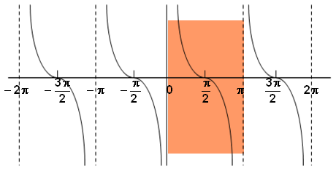
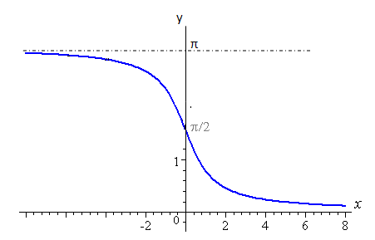
Inverse Cotangent Function: is defined by
y= Cot⁻¹ x or Arccot x if and only if cot y = x
for all real nos. of x (Domain: -∞ ≤ x ≤ ∞) and 0 < y < π (Range)
y=cot x, 0 < x < π
y= Cot⁻¹ x
Notes:
y= Tan⁻¹ x

Slide 9
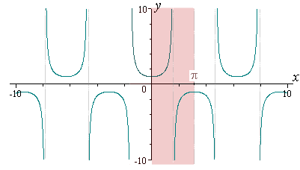
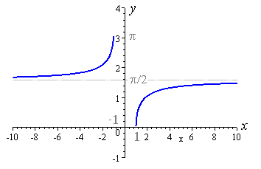
Inverse Secant Function: is defined by
y= Sec⁻¹ x or Arcsec x if and only if sec y = x
Domain: (-∞ ≤ x ≤ -1),(1≤ x ≤ ∞)
Range: 0 ≤ y < π/2, π/2 < y ≤ π
y=sec x, 0 ≤ x < π/2
π/2 < x ≤ π
y= Sec⁻¹ x
Notes:
y= Tan⁻¹ x

Slide 10
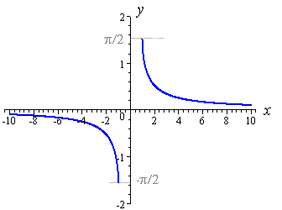
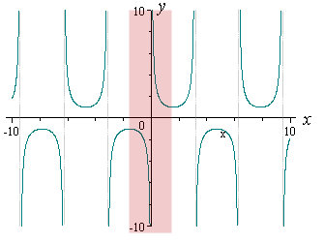
Inverse Cosecant Function: is defined by
y= Csc⁻¹ x or Arcscsc x if and only if csc y = x
Domain: (-∞ ≤ x ≤ -1),(1≤ x ≤ ∞)
Range: -π/2 ≤ y < 0, 0 < y ≤ π/2
y=csc x, -π/2 ≤ x < 0
0 < x ≤ π/2
y= Csc⁻¹ x

Slide 11
Principal Values refer to the restricted ranges of the inverse of the trigonometric functions.
We denote the principal values of inverse sine function as Arcsin x or Sin⁻¹ x
arcsin represents an infinite set of numbers whereas,
Arcsin represents only the single value π/4.
As you can observe, we use Arcsin x or Arccos x since we are dealing with the principal values of the inverse trigonometric functions.

Slide 12
Sample Problems:
I. Find the exact values of the ff:
a)
b)
c)
d)
II. Using your calculator (in radian mode), find:
a) Sin⁻¹ (0.82) = 0.96141
b) Sin⁻¹ (1/4) = 0.25268
Cos⁻¹ (4/5) = 0.6435
Tan⁻¹ (1) = 0.7854
Tan⁻¹ (-20) = -1.52084
Notes:
II. Using your

Slide 13
III. Find the exact value of each expression:
a)
b)
c)
d)
e)
Notes:
II. Using your

Slide 14
IV. Find
Using basic trigonometric identity:
Notes:
Using basic trigonometric identity:

Slide 15
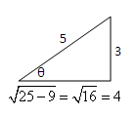
Using the concept of right triangle:
For other trigonometric functions
Notes:
For other trigonometric functions:

Slide 16
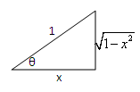
For
Using basic trigonometric identity:
Using the concept of right triangle:
Notes:
Using basic trigonometric identity:

Slide 17
For
Using basic trigonometric identity:
Using the concept of right triangle:

